Slide 1

CryptoCurrency Advisory/ Trading Bot
Mehrdad Akhlaghi
Cindy Chen
Sargun Singh
Tito K

Slide 2

Project Proposal
Scope: For this project, our group has decided to develop a Cryptocurrency Advisory Bot, which will use machine learning technology models such as:
Neural Network
We have chosen neural networks as we believe
it has higher capacity and output
they are versatile
it can improve accuracy though multiple training and testing process.
detect complex nonlinear relationships between dependent and independent variables, ability to detect all possible interactions between predictor variables, and the availability of multiple training
This advisory bot will indicate the following signals:
Buy,
Sell
Hold

Slide 3
Project Proposal
Indicators:
Finta python library will be used to generate signals along with usage of SMA.
Simple Moving day Averages (SMA) (Long and Short)
SMA is a great option for our indicator as it uses both long and short term moving average, which can be very helpful in understanding a cryptocurrency trajectory, as well entry and exit.
Relative Strength Index (RSI)
Fear and greed index (This is through an API. The F&G index can provide a better visualization on human/market emotions. When paired with SMA, we can get much better understanding when to sell, buy or hold. )
Neural Networks-Deep Learning (for back testing)
Bollinger Bands
It helps determine whether prices are high or low on a relative basis. Bollinger Bands are separated into 2 bands, upper and lower bands with SMA being utilized together.

Slide 4

Litecoin Trading Bot
Litecoin ranks in the Top 15 largest cryptocurrencies in terms of market capitalization
Designed to produce four times as many blocks as Bitcoin
Data from Yahoo Finance API

Slide 5
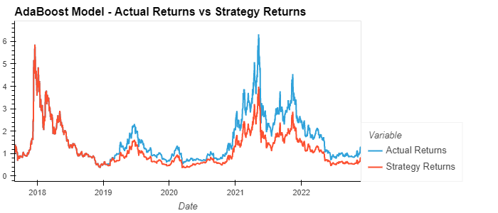
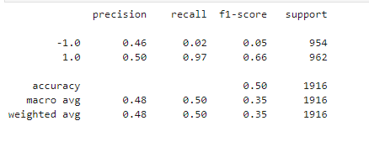
Litecoin: Adaptive Boosting Machine Learning
Cumulative Actual Returns vs Predicted Return
Classification Report :
1: Positive actual return
-1: Negative actual return

Slide 6
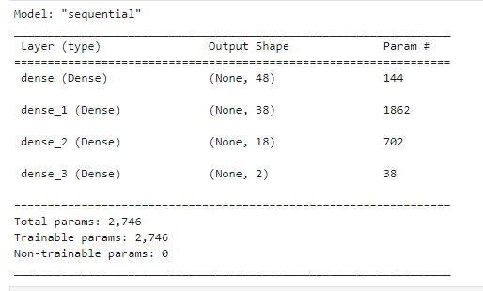
Litecoin: Neural Network for trading type
Pre-set for trading advisory bot
Use Kares Sequential Model with 3 hidden layers
Fit the model with 120 epochs running and testing accuracy and loss
Forecast trading type decision: buy, sell, hold
8 years data used from 2014 to 2022

Slide 7
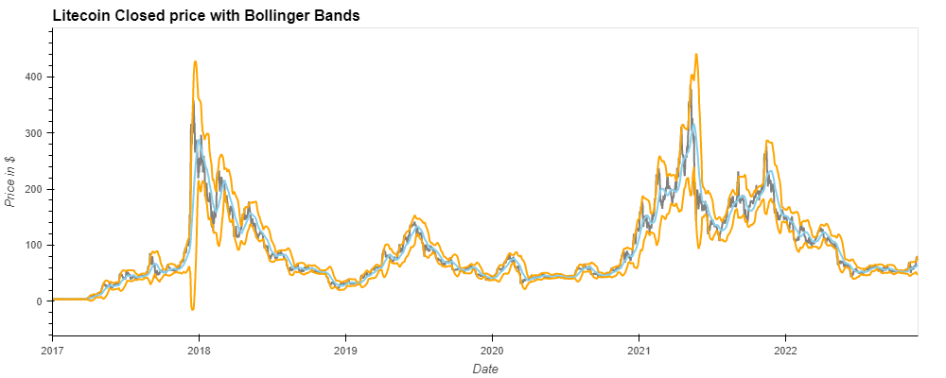
Litecoin: Bollinger Bands Indicator
Orange: Upper and Lower Bands
Grey: Closed Price
Blue: Middle Band

Slide 8
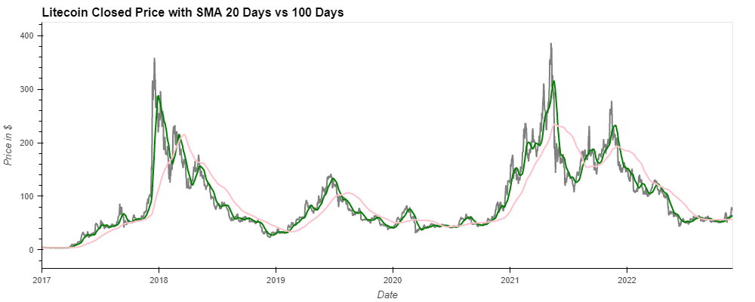
Litecoin: SMA 20 Days vs 100 Days
Grey: Closed Price
Green: SMA 20 Days
Pink: SMA 100 Days

Slide 9
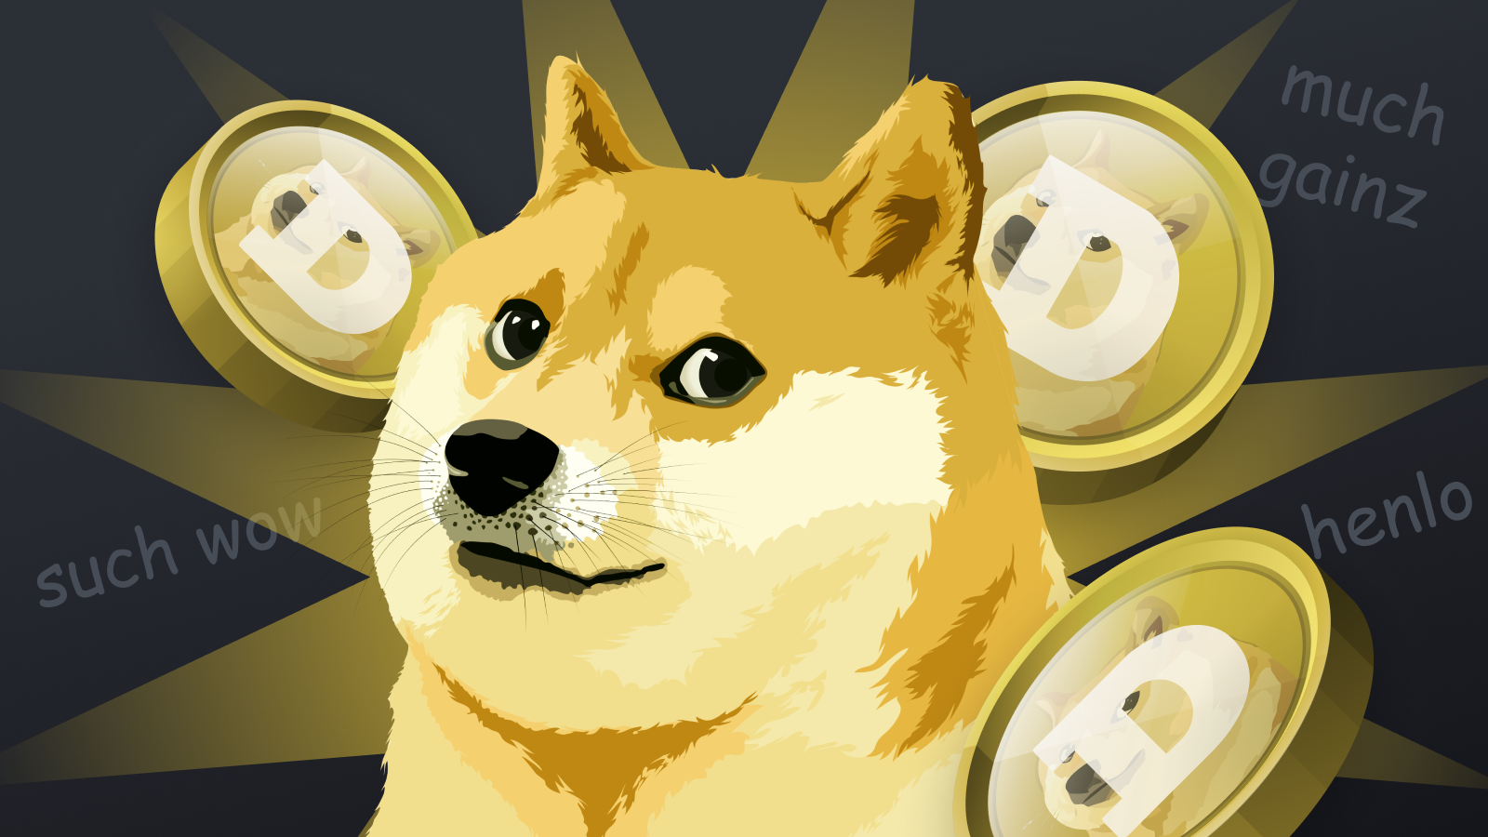
Dogecoin Trading Bot
A cryptocurrency known as Dogecoin was created in 2013 by Jackson Palmer and Billy Markus. The Japanese dog breed Shiba Inu serves as the logo for Dogecoin. It shares the same proof-of-work algorithm as Litecoin.

Slide 10
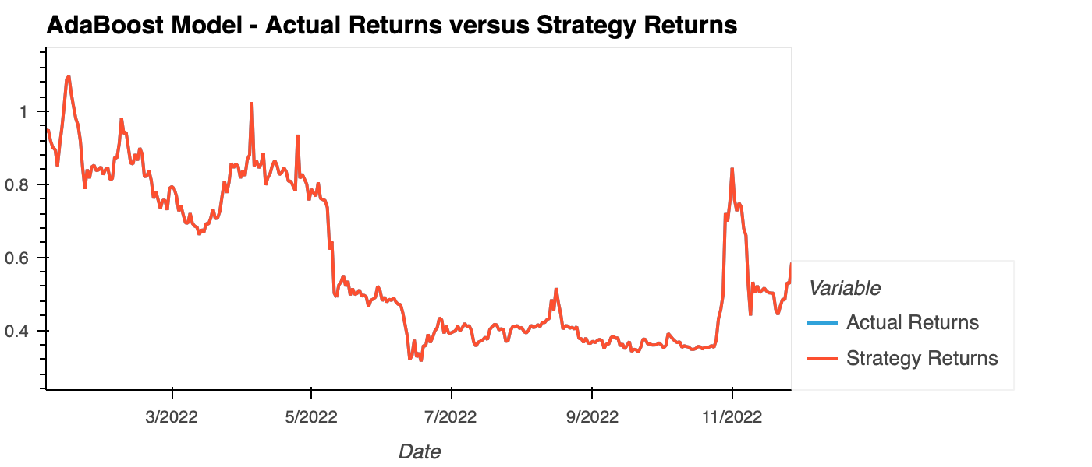
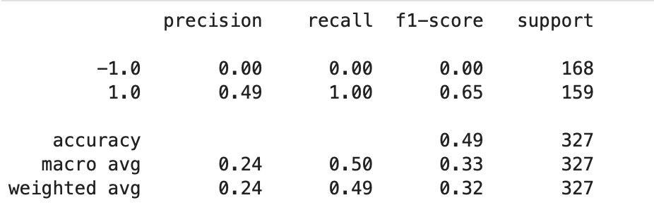
Dogecoin: Adaptive Boosting Machine Learning
Cumulative Actual Returns vs Predicted Return
Classification Report :
1: Positive actual return
-1: Negative actual return

Slide 11
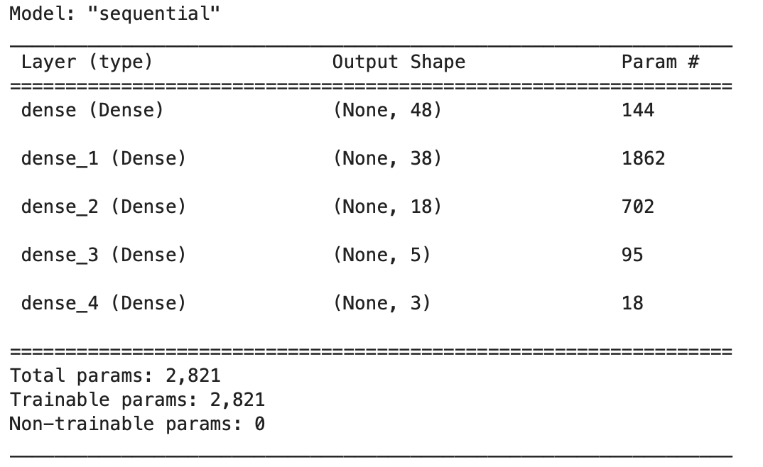
Dogecoin: Neural Network for trading type
Tested the model's accuracy and loss using 120 running epochs.
8-year data from 2014 to 2022 are utilized
makes forecast trading type decisions, including buy, sell, and hold.

Slide 12
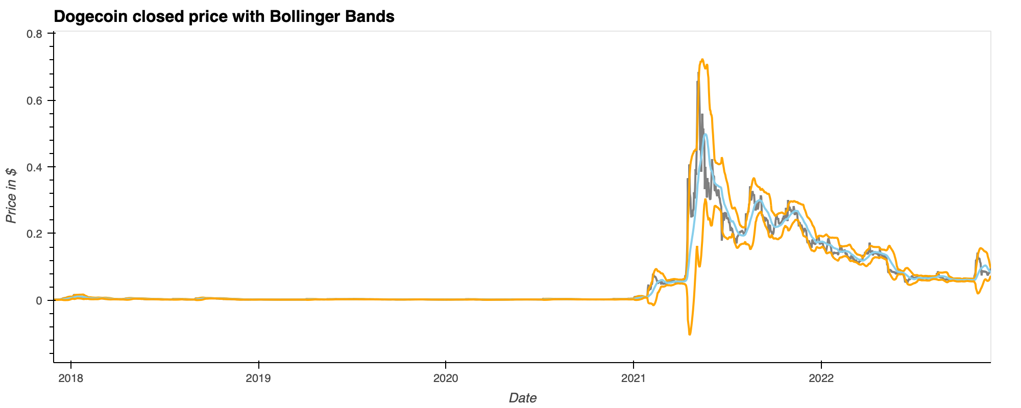
Dogecoin: Bollinger Bands Indicator
Orange: Upper and Lower Bands
Grey: Closed Price
Blue: Middle Band

Slide 13
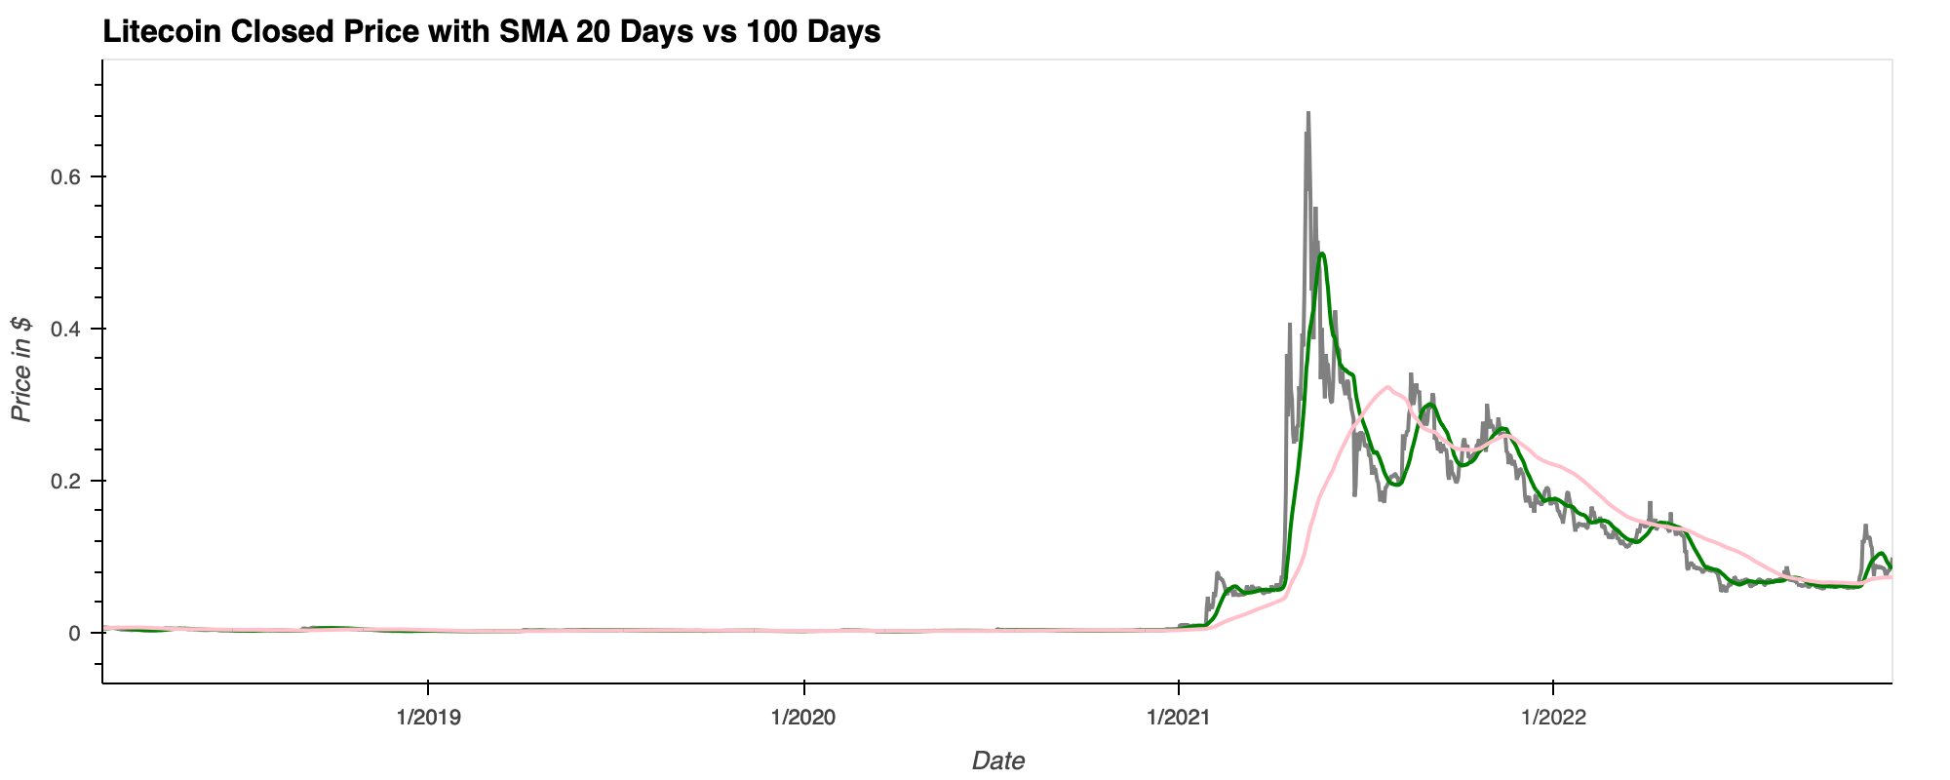
Dogecoin: SMA 20 Days vs 100 Days
Grey: Closed Price
Green: SMA 20 Days
Pink: SMA 100 Days

Slide 14


Thank You
Questions

